Slide 1
Best Practices for Effective Dashboards
Dashboard Doctor Session

Slide 2
What is a dashboard?
"A dashboard is a visual display of the most important information to achieve one or more objectives; consolidated and arranged on a single screen so the information can be monitored at a glance."
Stephen Few

Slide 3

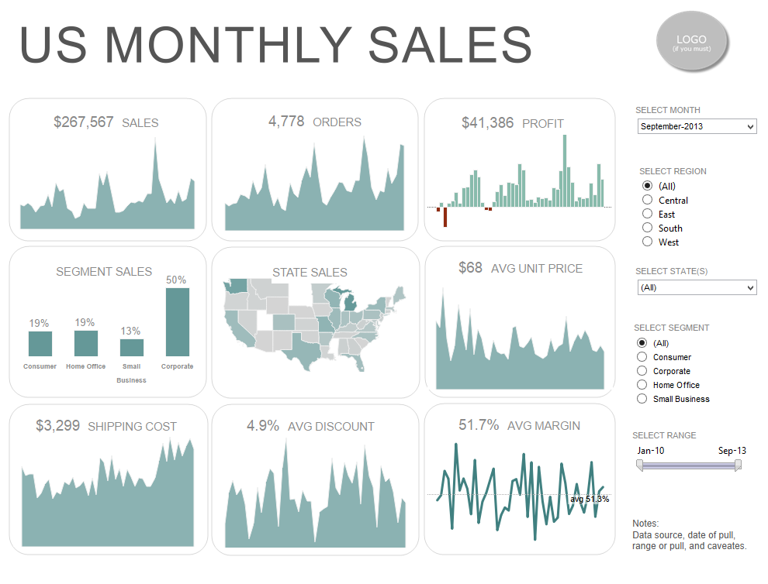
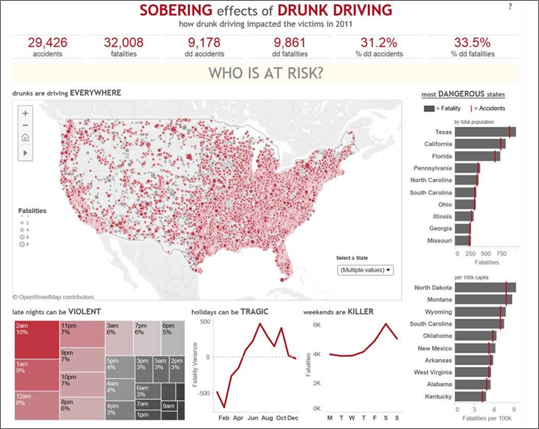
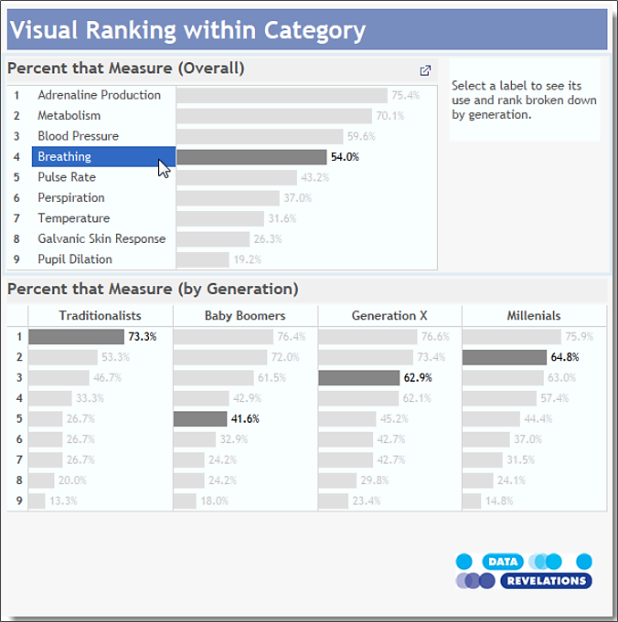
Good Dashboards

Slide 4
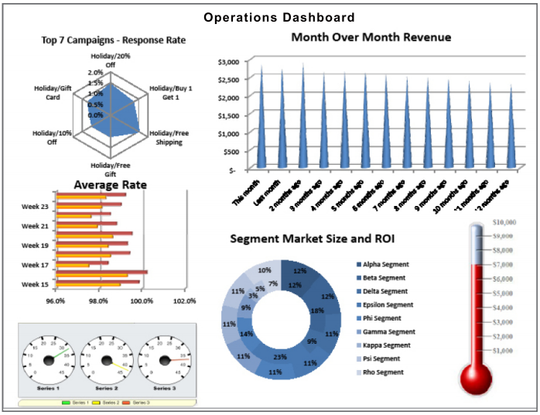
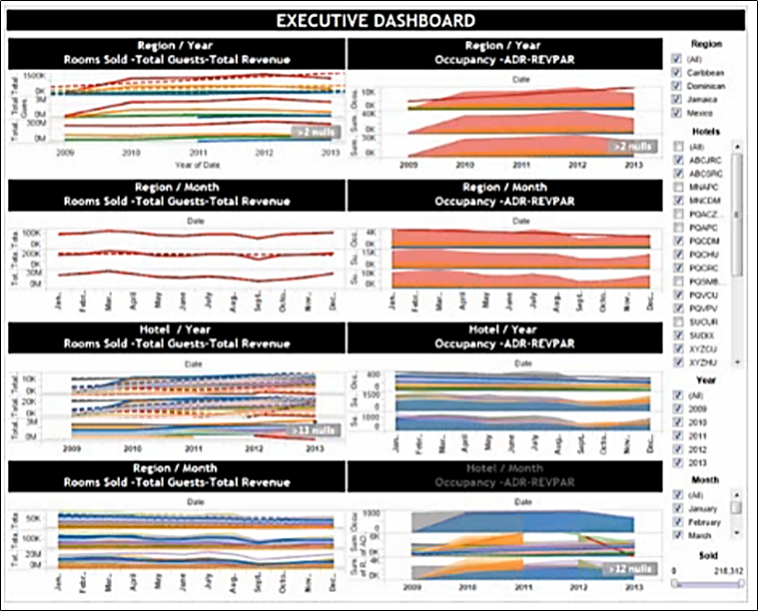
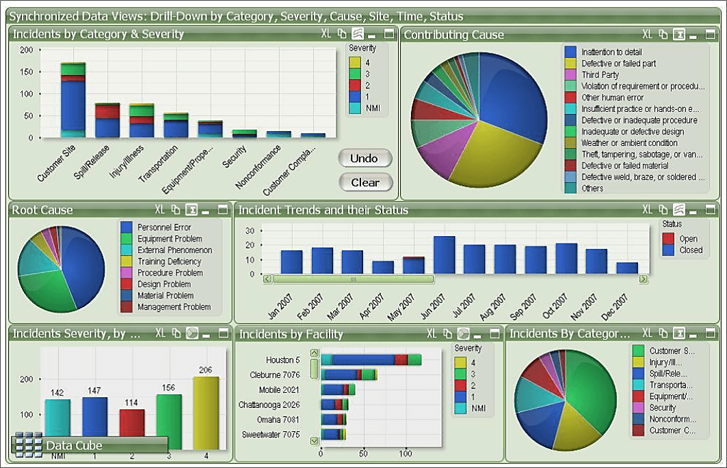
Bad Dashboards

Slide 5
Best Practices for Effective Dashboards
Identify your goal
Design for the real world
Choose metrics that matter
Keep it visual
Build in functionality
Avoid chart junk
Follow the 4 C’s of Visualization
Finalize with Tableau’s dashboard checklist

Slide 6
1. Identify your goal
Know your purpose and audience/consumer
Know your dashboard type
Strategic: executive, high-level
Operational: immediate use, sales information, pulse
Analytic: drill-down, highly interactive
What value will the dashboard add?
Does the dashboard...
...help management define what is important?
...educate people in the organization about the things that matter?
...set goals and expectations for specific individuals or groups?
...help executives sleep at night because they know what’s going on?
...encourage specific actions in a timely manner?
...highlight exceptions and provide alerts when problems occur?
...communicate progress and success?
...provide a common interface for interacting with and analyzing important business data?
Leverage the most viewed spot

Slide 7
2. Design for the real world
Author at your final display size
Limit the number of views to three or four
(unless there is an absolute need)
Implement an iterative improvement process based on user feedback

Slide 8
3. Choose metrics that matter
Metrics must be relevant to the goal.
Ask the following questions when deciding which metrics to include in your dashboard:
How does each metric contribute to those objectives?
Do you have data, either internal or external, that can shed light on the objectives?
Can you design a meaningful metric that measures those contributions?
Is this metric truly necessary to contribute to the objectives?
Can you build a systematic and on-going means of measurement?

Slide 9
4. Keep it visual
Cognition & Visual Perception
Gestalt Theory & Design Principals
Color choice
Design for Accessibility: avoid red-green and 'stop light' palette (red-yellow-green)
Stay on-brand and on-theme (online color palette tools make this easy)
Font choice
Chart choice
White space
Information grouping
Most important data on X and Y axes; encode less important data in color or shape attributes
Pre-Attentive Attributes / Enduring Dispositions
Make it easy for your audience to understand your message

Slide 10
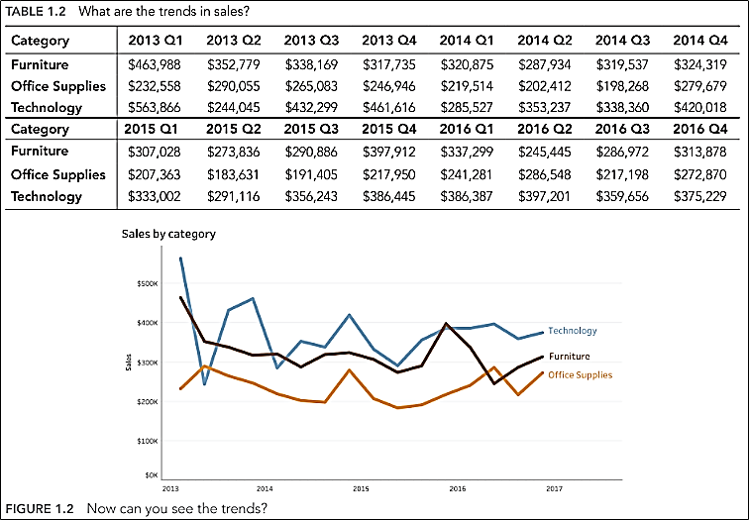
Cognition & Visual Perception
Vision is among our keenest senses
Our brains process visual information faster and more efficiently than text
Our visual system has been processing information long before language was ever developed
Chart v Tabular data presentation – which do you prefer?

Slide 11
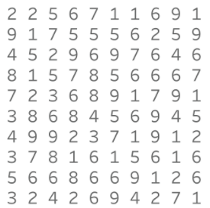
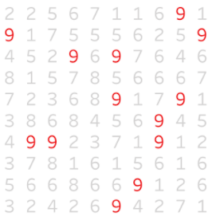
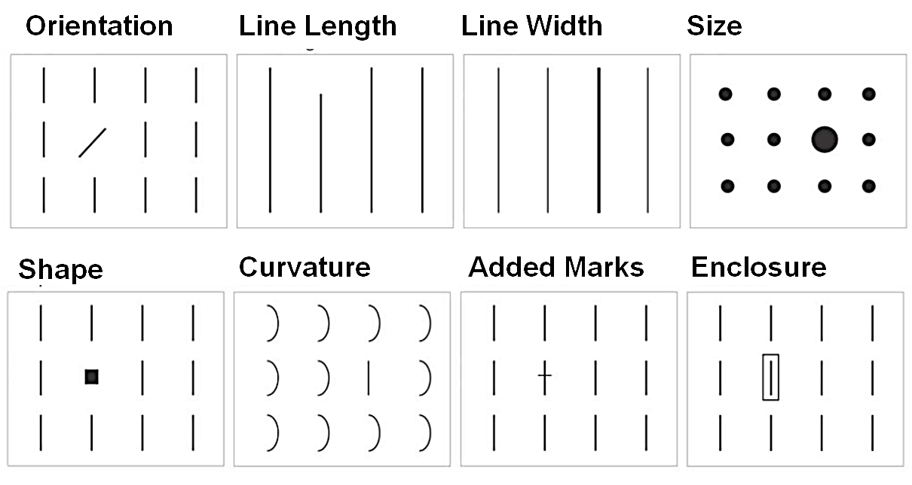
Pre-Attentive Attributes / Enduring Dispositions
Color
VS
Form

Slide 12
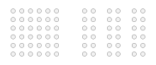
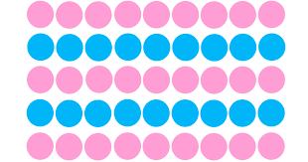
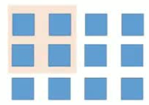
Gestalt Theory & Design Principals
Theory
The mind is constantly trying to make sense of the world; when the human mind (perceptual system) forms a percept or "gestalt", the whole has a reality of its own, independent of the parts.
Principals (8):
Proximity (objects close to each other are perceived as a group)
Similarity (elements tend to be integrated into groups if they are similar to each other)
Enclosure (objects with a boundary surrounding them are perceived to belong together)

Slide 13
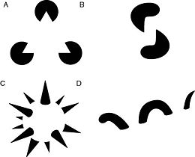

Gestalt Examples
Reification
Illusory contours
Constructive or generative aspect of perception, by which the experienced percept contains more explicit spatial information than the sensory stimulus on which it is based.
The whole is other than the sum of the parts
Multistability (Multistable Perception) /
Figure-Ground Articulation
Tendency of ambiguous perceptual experiences to pop back and forth unstably between two or more alternative interpretations.
E.g. Necker cube and
Rubin's Figure/Vase illusion

Slide 14
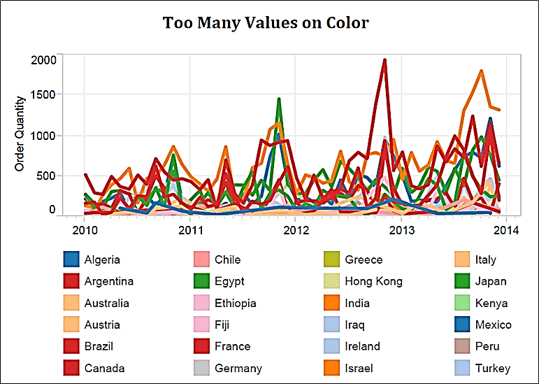
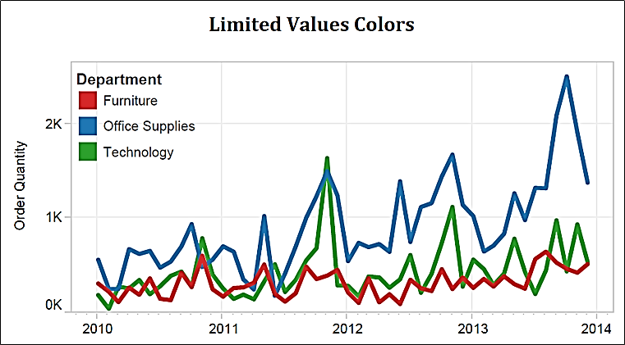
Color Choice
Limit to 7 or less colors
VS

Slide 15
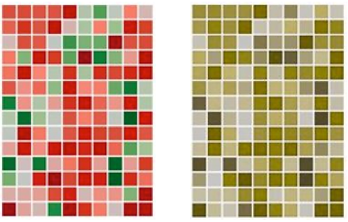
Design for Accessibility
Color Vision Deficiency (color blindness)
affects ~10% population

Slide 16
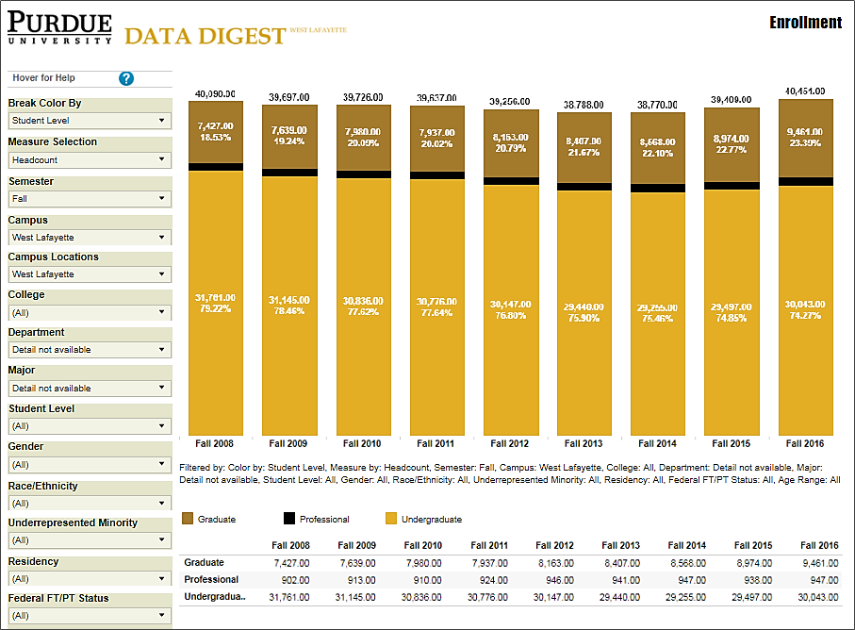
Stay On-Brand / On-Theme
Utilize online color palette generators

Slide 17

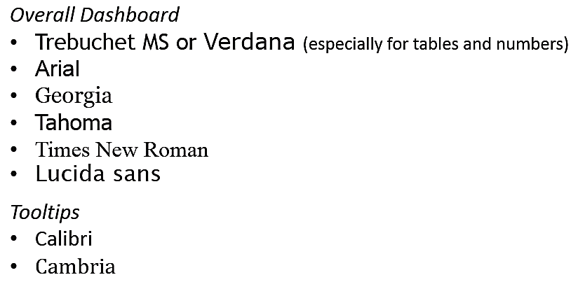
Font Choice
Avoid scripts:
Recommended fonts

Slide 18
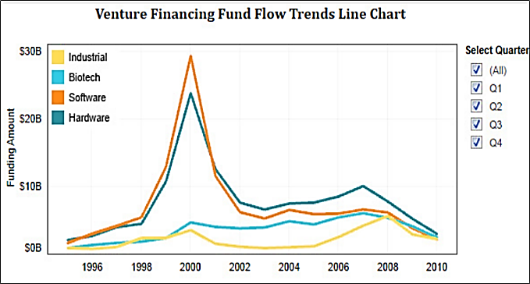
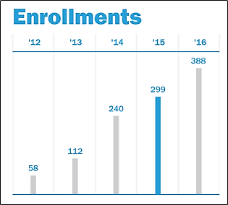
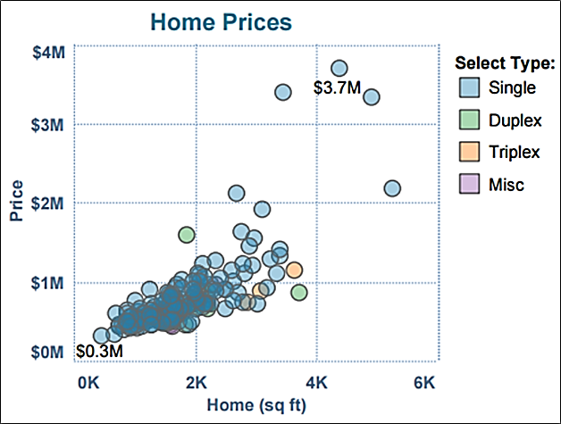
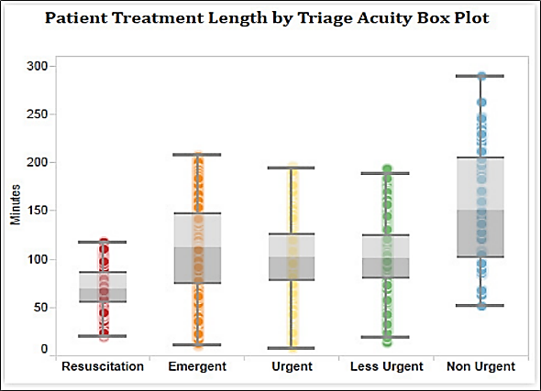
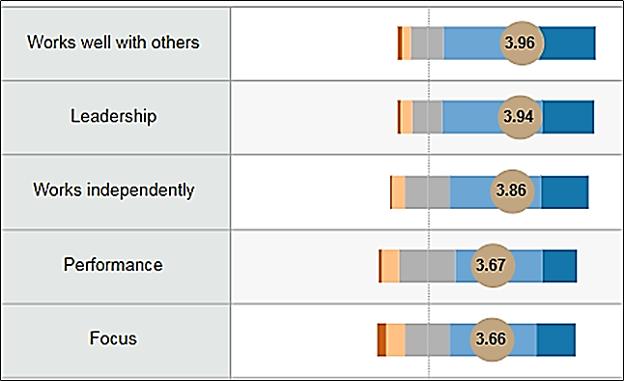
Choose the Right Chart Type
Trends over Time:
line chart
Comparison & Ranking:
bar chart
Correlation:
scatterplot
Distribution:
box plot
Likert Scale:
divergent bar chart

Slide 19
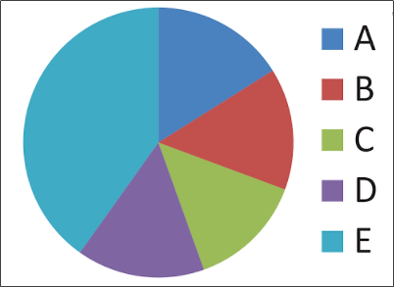
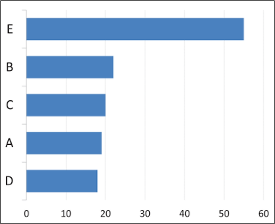
Avoid Pie Charts
Much harder for humans to differentiate differences in circles or angles than lines
VS

Slide 20
5. Build in functionality
Add interactivity to encourage exploration
Drill-downs
Allow users to go from a summary metric/view to deeper detail that provides more context and/or breakout of the information.
Show filters and parameters
Enable highlighting
Action filters
Tooltips

Slide 21
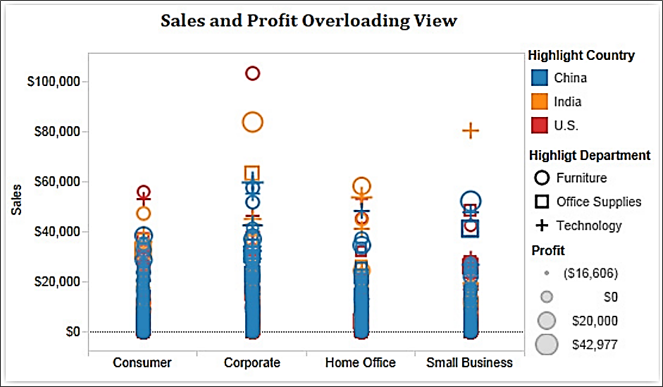
6. Avoid chart junk
Unless it serves a purpose, don't include it
E.g. 3D effects, image overload, chart shading, label overload
Prioritize data-to-ink ratio
Resist temptation to use purely decorative chart types
Avoid chart overload

Slide 22
7. Follow the 4 C’s of Visualization
Clarity
Defined audience, clear message, ease of understanding
Concise
Balance minimalism with detail, brevity with comprehensiveness
Captivating
Attracts and holds attention, is interesting
Catalyst
Prompts action

Slide 23
8. Tableau check list
What questions are you trying to answer?
Does this visualization answer all of your questions?
Is the purpose of the visualization clearly explained in its title or surrounding text?
Can you understand the visualization in 30 seconds or less, without additional information?
Does your visualization include a title? Is that title simple, informative, and eye-catching?
Does your visualization include subtitles to guide your viewers?
Do you have the right chart type for your analysis?
What types of analysis are you performing?
Have you selected the most suitable chart type(s) for your types of analysis?
Have you considered alternative chart types that could work better than the ones you have chosen?
Are your views effective?
Are your most important data shown on the X- and Y-axes and your less important data encoded in color or shape attributes?
Are your views oriented intuitively—do they cater to the way your viewers read and perceive data?
Have you limited the number of measures or dimensions in a single view so that your users can see your data?
Have you limited your usage of colors and shapes so that your users can distinguish them and see patterns?

Slide 24
8. Tableau check list (cont.)
4. Is your dashboard holistic?
Do all your views fit together to tell a single story?
Do all your views flow well from one to the next? Are they in a good order?
Do your most important views appear in the top or top-left corner?
Are secondary elements in your dashboard placed well so they support the views without interrupting them?
Are your filters in the right locations?
Do your filters work correctly? Do views become blank or downright confusing if you apply a filter?
Do your filters apply to the right scope?
Are your filter titles informative? Can viewers easily understand how to interactive with your filters?
Are your legends close to the views they apply to?
Is your legend highlight button set to “on” or “off” according to your preference?
Do you have filter, highlight or URL actions? If so, do they work?
Are your legends and filters grouped and placed intuitively?
Do you have scrollbars in your views? If so, are they acceptable ones?
Are your views scrunched?
Do your views fit consistently well when you apply filters?
5. Did you perfect your work?
Do all the colors on your dashboard go together without clashing?
Do you have less than 7-10 colors on your dashboards?
Do you use fonts consistently in all of your views and no more than three different fonts on one dashboard?
Are you labels clear and concise? Are they placed optimally to help guide your viewers? Make sure subtitles are formatted to be subordinate to the main title.
Are you tooltips informative? Do they have the right format so that they’re easy for viewers to use?

Slide 25
Sources
Best Practices for Effective Dashboards (Tableau Manual)
5 Best Practices for Creating Effective Dashboards (Tableau)
A Guide to Creating Dashboards People Love to Use
Stephen Few: Dashboard Formatting & Layout
Visual Analysis Best Practices Simple Techniques for Making Every Data Visualization Useful and Beautiful
The Big Book of Dashboards: Visualizing Your Data Using Real-World Business Scenarios
Essential Design Principles for Tableau (Coursera)
3 Ways To Make Lovely Line Graphs In Tableau

